Slide 1
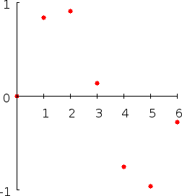
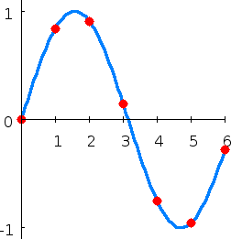
Interpolation
A method of constructing a function that crosses through a discrete set of known data points.
.

Slide 2
spline interpolation is a form of interpolation where the interpolant is a special type of piecewise polynomial called a spline.
Spline interpolation is often preferred over polynomial interpolation because the interpolation error can be made small even when using low degree polynomials for the spline.
Spline interpolation avoids the problem of Runge’s phenomenon , in which oscillation can occur between points when interpolating using high degree polynomials.

Slide 3
Runge’s phenomenon

Slide 4
Spline interpolation

Slide 5
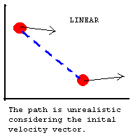
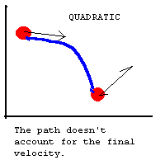
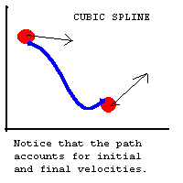
Spline Interpolation
Linear, Quadratic, Cubic
Preferred over other polynomial interpolation
More efficient
High-degree polynomials are very computationally expensive
Smaller error
Interpolant is smoother

Slide 6
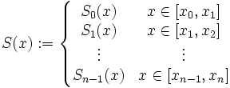
Spline Interpolation Definition
Given n+1 distinct knots x_{i} such that:
with n+1 knot values y_{i} find a spline function
with each S_{i}(x) a polynomial of degree at most n.

Slide 7



Linear Spline Interpolation
Simplest form of spline interpolation
Points connected by lines
Each S_{i} is a linear function constructed as:
Must be continuous at each data point:
Continuity:

Slide 8
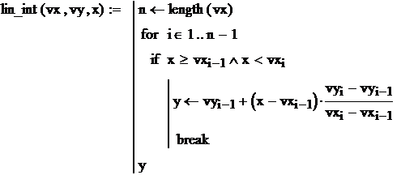
Linear Spline Interpolation by MathCAD

Slide 9


Quadratic Spline Interpolation
The quadratic spline can be constructed as:
The coefficients can be found by choosing a z₀ and then using the recurrence relation:

Slide 10
Quadratic Splines 2
Quadratic splines are rarely used for interpolation for practical purposes
Ideally quadratic splines are only used to understand cubic splines

Slide 11
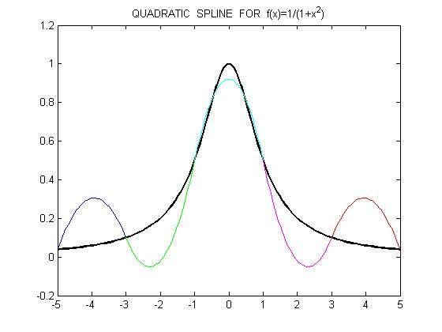
Quadratic Spline Graph
t=a:2:b;

Slide 12
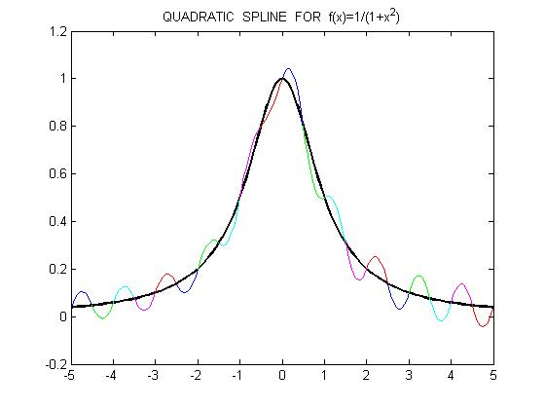
Quadratic Spline Graph
t=a:0.5:b;

Slide 13
Natural Cubic Spline Interpolation
SPLINE OF DEGREE k = 3
The domain of g is an interval [a,b].
g, g’, g’’ are all continuous functions on [a,b].
There are points x_{i} (the knots of g) such that a = x₀ < x₁ < .. x_{n} = b and such that g is a polynomial of degree at most k on each subinterval [x_{i}, x_{i+1}].
x
x₀
x₁
…
x_{n}
y
f₀
f₁
…
f_{n}
x_{i} are knots

Slide 14
Natural Cubic Spline Interpolation
g_{i}(x) is a cubic polynomial that will be used on the subinterval [ x_{i}, x_{i+1} ].
g_{i}(x) = a_{i}x³ + b_{i}x² + c_{i}x + d_{i}
4 Coefficients with n subintervals = 4n equations
There are 4_{n-2} conditions
Interpolation conditions
Continuity conditions
Natural Conditions
g’’(x₀) = 0
g’’(x_{n}) = 0

Slide 15
Cubic spline/ general formula

Slide 16
Natural Cubic Spline Interpolation
Algorithm
Define g’’(x_{i})
note: on each [x_{i}, x_{i+1}] g’’ is a linear polynomial with g_{i}’’(x_{i}) = f_{i}, g_{i}’’ (x_{i+1}) = f_{i+1}
Then calculate all values of the step
h_{i} = x_{i+1} – x_{i}
Create a system
Solve the system for determining the
m_{i} =g_{i}’’(x_{i})

Slide 17
The system for determining m_{i}

Slide 18
Matrix form of the system

Slide 19
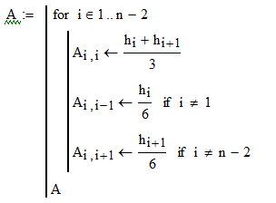
Matrix form of the system(1)

Slide 20
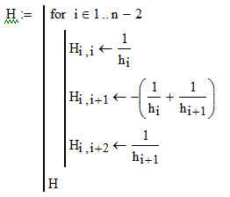
Matrix form of the system(2)

Slide 21
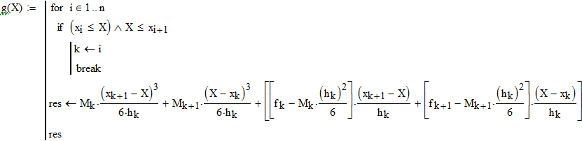
Function for creating a spline

Slide 22
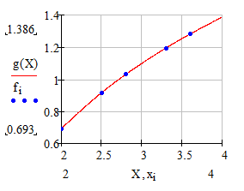
Geometrical interpretation

Slide 23
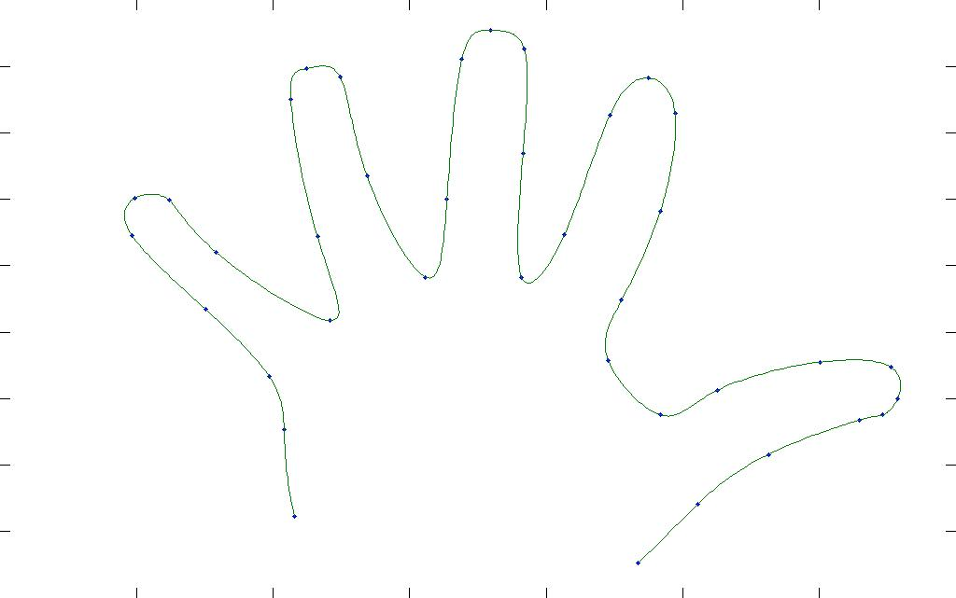
Hand spline interpolation

Slide 24
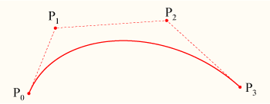
Bezier Spline Interpolation
A similar but different problem:
Controlling the shape of curves.
Problem: given some (control) points, produce and modify the shape of a curve passing through the first and last point.
http://www.ibiblio.org/e-notes/Splines/Bezier.htm

Slide 25
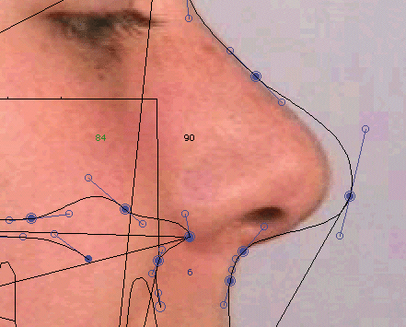
Bezier Spline Interpolation
Practical Application

Slide 26
Bezier Spline Interpolation
Idea: Build functions that are combinations of some basic and simpler functions.
Basic functions: B-splines
Bernstein polynomials

Slide 27

Bernstein Polynomials
Definition 5.5: Bernstein polynomials of degree N are defined by:
For v = 0, 1, 2, …, N, where N over v = N! / v! (N – v)!
In general there are N+1 Bernstein Polynomials of degree N. For example, the Bernstein Polynomials of degrees 1, 2, and 3 are:
1. B_{0,1}(t) = 1-t, B_{1,1}(t) = t;
2. B_{0,2}(t) = (1-t)², B_{1,2}(t) = 2t(1-t), B_{2,2}(t) = t²;
3. B_{0,3}(t) = (1-t)³, B_{1,3}(t) = 3t(1-t)², B_{2,3}(t)=3t²(1-t), B_{3,3}(t) = t³;

Slide 28
Bernstein Polynomials
Given a set of control points {P_{i}}^{N}_{i=0}, where P_{i} = (x_{i}, y_{i}), Definition 5.6: A Bezier curve of degree N is:
P(t) = ^{N}_{i=0} P_{i}B_{i,N}(t),
Where Bi,N(t), for I = 0, 1, …, N, are the Bernstein polynomials of degree N.
P(t) is the Bezier curve
Since P_{i} = (x_{i}, y_{i})
x(t) = ^{N}_{i=0}x_{i}B_{i,N}(t) and y(t) = ^{N}_{i=0}y_{i}B_{i,N}(t)
Easy to modify curve if points are added.

Slide 29
Bernstein Polynomials Example
Find the Bezier curve which has the control points (2,2), (1,1.5), (3.5,0), (4,1). Substituting the x- and y-coordinates of the control points and N=3 into the x(t) and y(t) formulas on the previous slide yields
x(t) = 2B_{0,3}(t) + 1B_{1,3}(t) + 3.5B_{2,3}(t) + 4B_{3,3}(t)
y(t) = 2B_{0,3}(t) + 1.5B_{1,3}(t) + 0B_{2,3}(t) + 1B_{3,3}(t)

